Slide 1
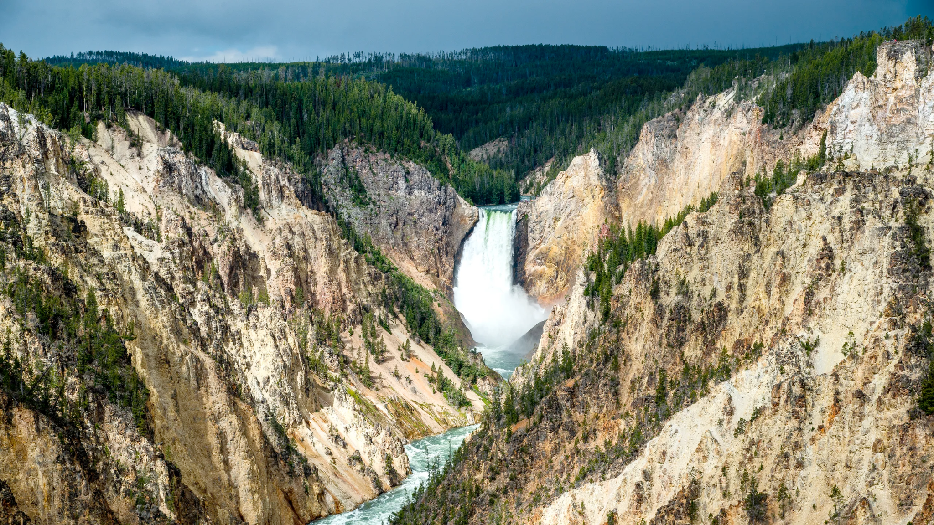
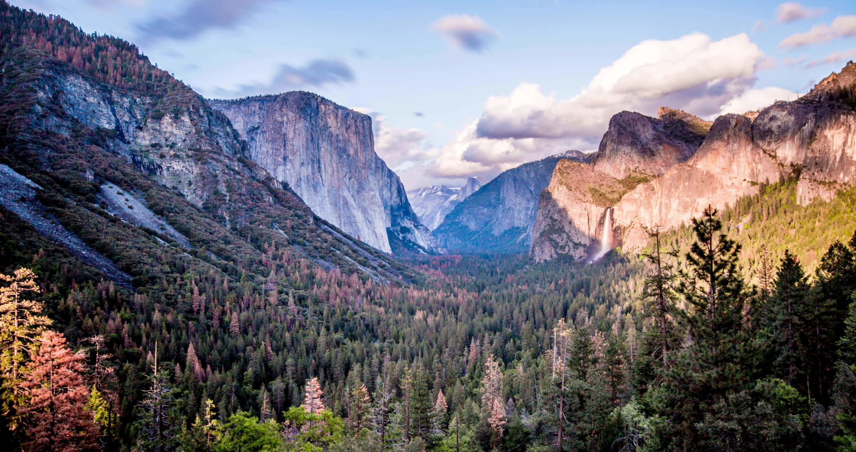
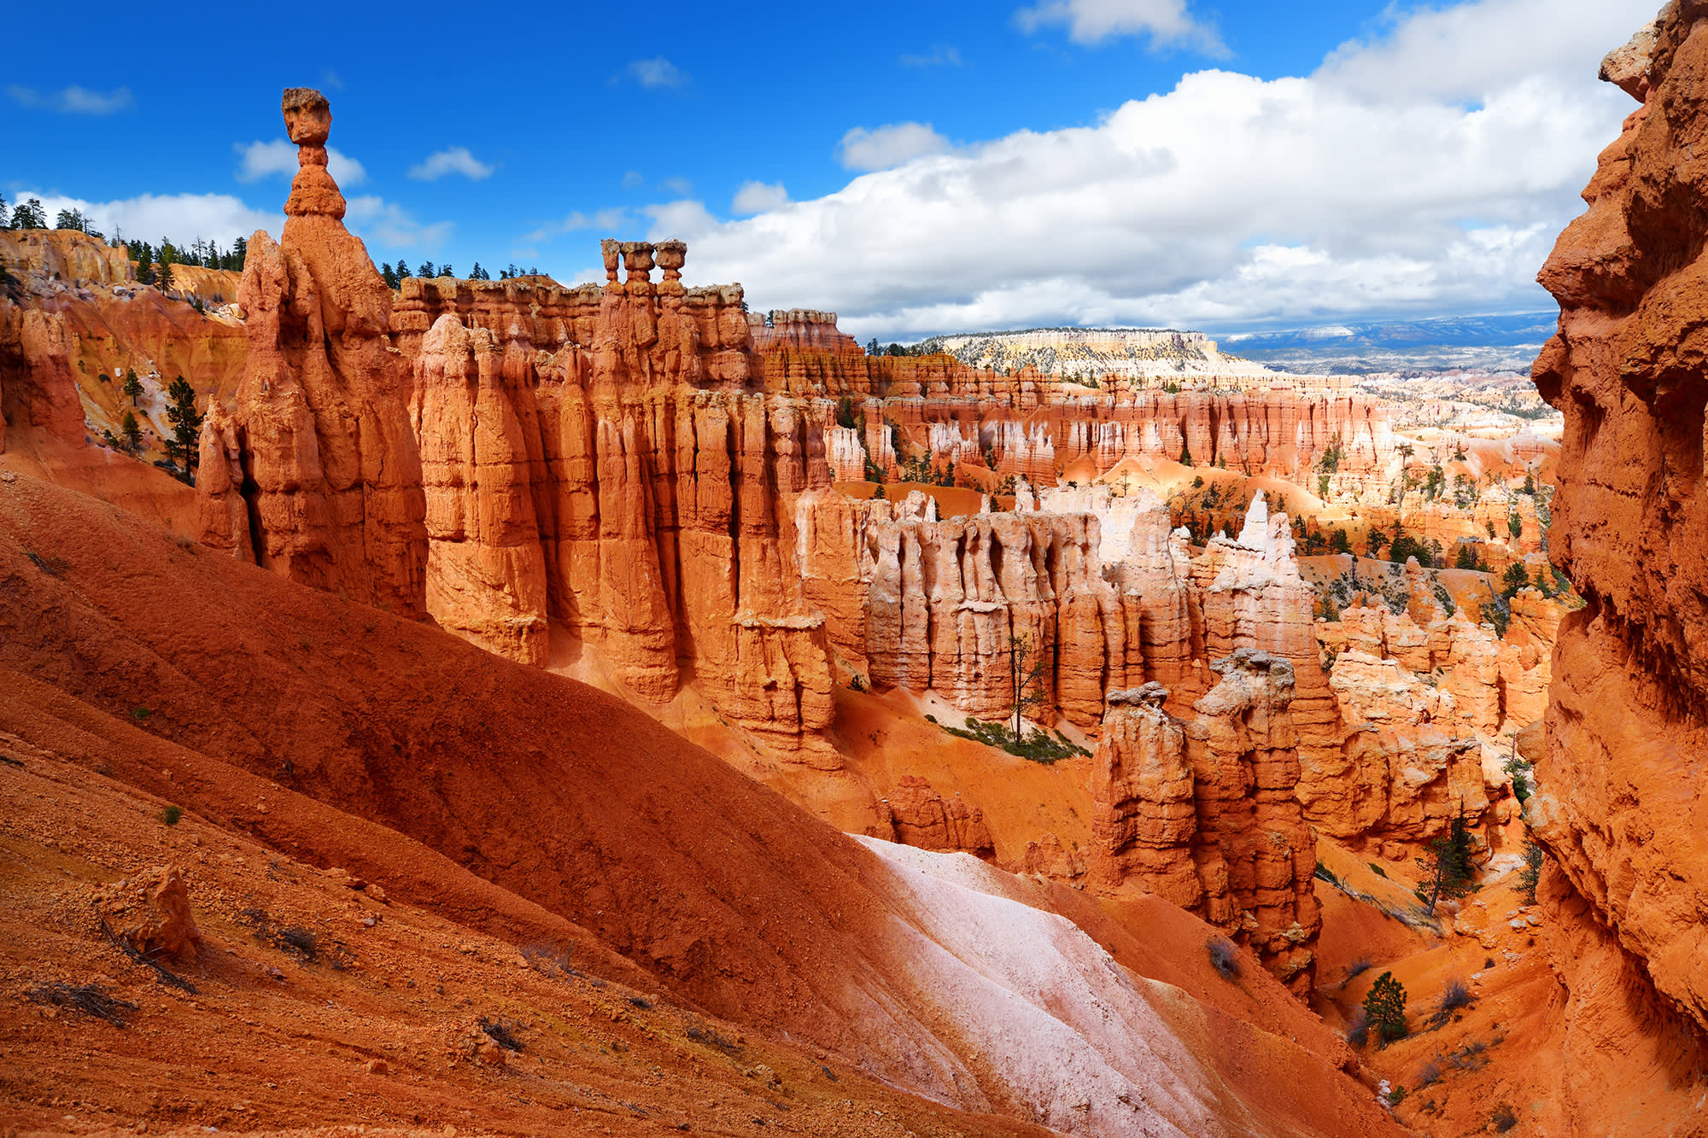
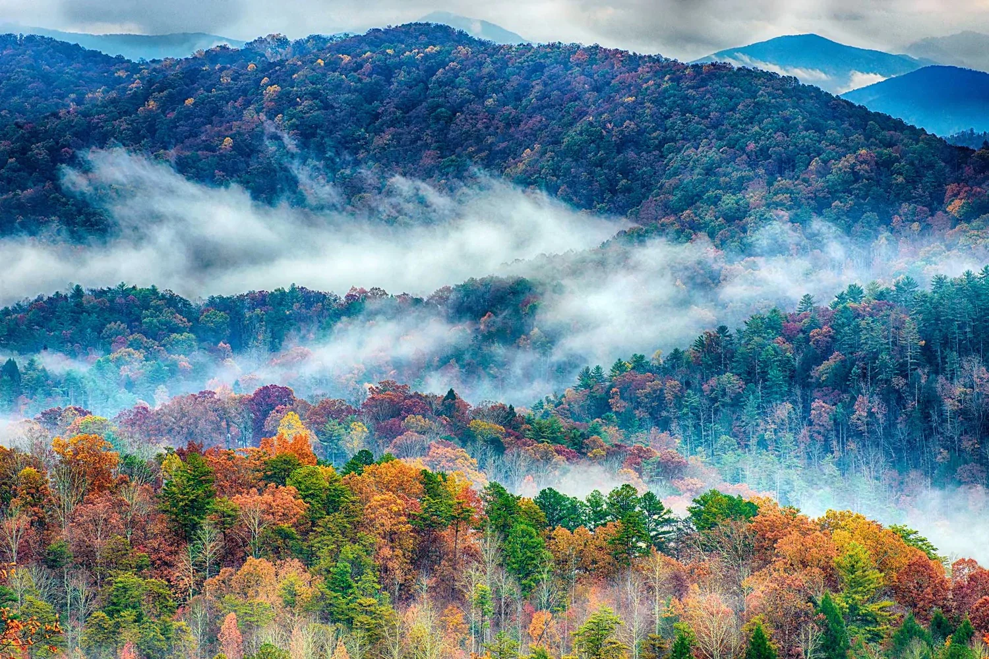
National Parks Service Biodiversity
A Codecademy Portfolio Project
by Leah M. Fulmer
P.S. This presentation includes animations. For the full experience, play slideshow with Cmd+Enter.

Slide 2
Yellowstone
(Wyoming)
Yosemite
(California)
DIVERSE
ECOSYSTEMS
=
DIVERSE
INHABITANTS
Bryce Canyon
(Utah)
Great Smoky Mountains
(Tennessee / North Carolina)

Slide 3

Summary
Data related to biodiversity in National Parks; given by Codecademy as an application of data science skills.
Questions regarding both data distributions between parks and conservation status of creatures within parks.
Analysis detects unrealistic uniformity between parks with respect to proportions of species observed and emphasizes conservation among birds and mammals.
Conclusions focus on data quality and source.
Recommendations expand beyond data quality into including environmental conditions and citizen scientists.
Yellowstone

Slide 4
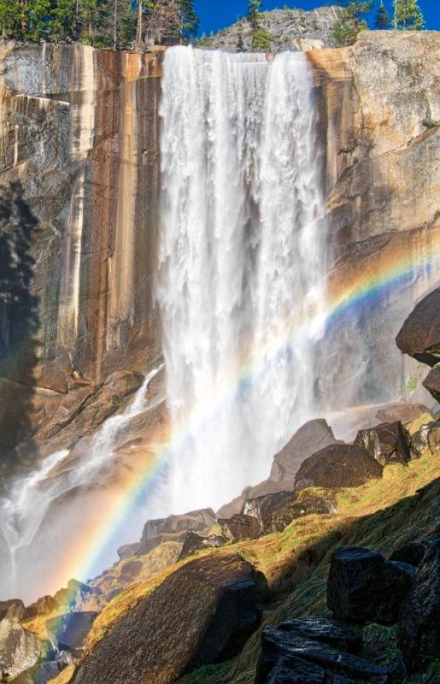
Data
Two datasets provided by Codecademy:
observations.csv –
scientific_name
park_name
observations
species_info.csv –
scientific_name
common_names
category
conservation_status
Yosemite

Slide 5
Data
One dataset used in Jupyter Notebook analysis after wrangling and joining:
combined –
scientific_name
park_name
observations
common_names
category
conservation_status
Yosemite

Slide 6
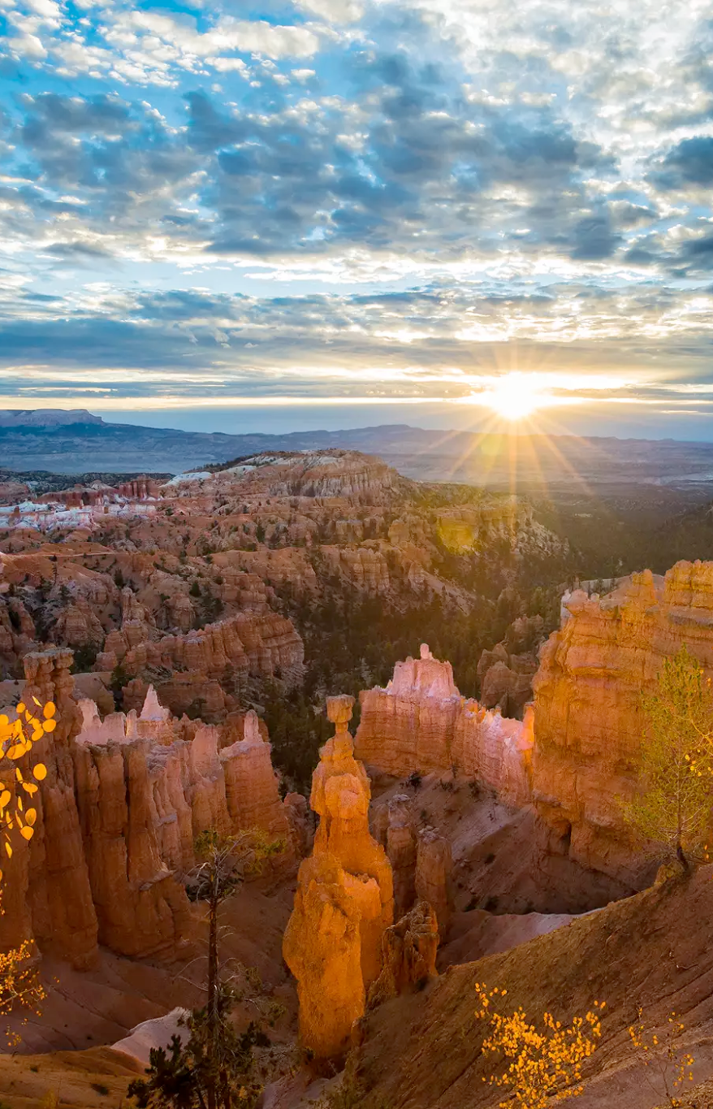
Questions
Two types of questions for analysis:
Data Distributions –
Which National Parks make the most observations?
Which categories of species do they observe?
How many of these are flagged for conservation?
Conservation Analysis –
Which conservation status is most populated?
Which species categories does it contain?
Which categories have the highest proportions of species flagged for conservation?
Bryce Canyon

Slide 7
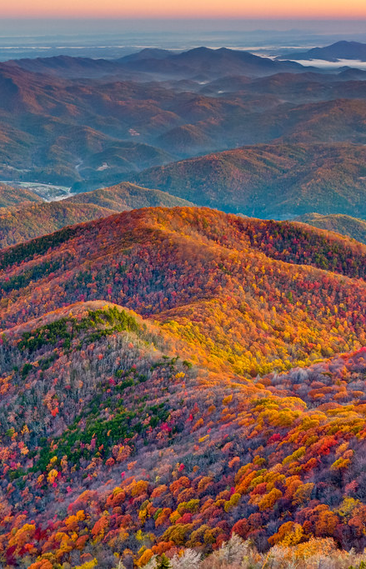
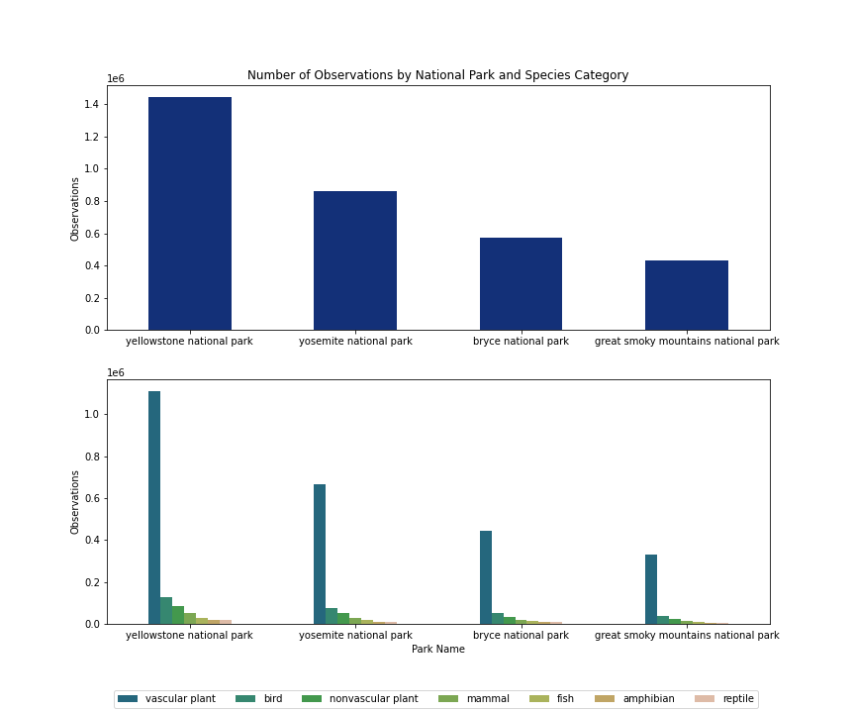
Analysis
Yellowstone National Park makes the most observations.
Among every park, vascular plants are by far the most observed category, making other categories difficult to see.
Let's drop vascular plants from our dataset and take a closer look at the distribution of observations in the other categories.
Great Smoky Mountains

Slide 8
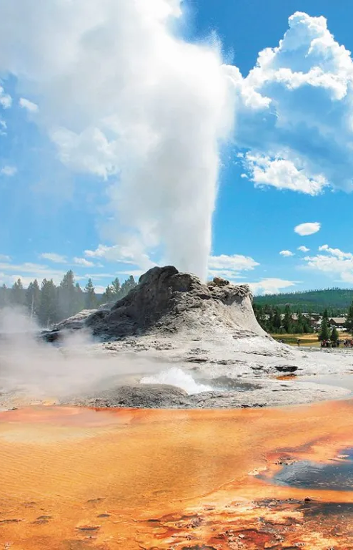
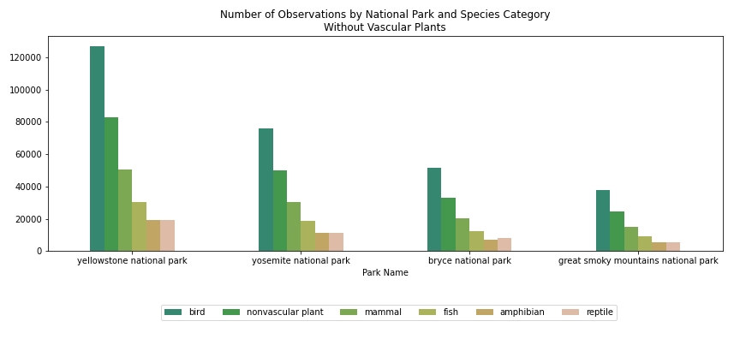
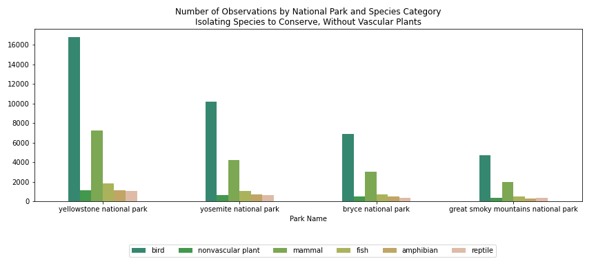
Analysis
The distribution of observations among every park takes a suspiciously similar shape.
This means that we cannot make meaningful conclusions about which ecosystems may be (dis)advantageous to endangered or conserved species.
Perhaps the data was simulated by Codecademy to achieve all of the specific data-cleaning challenges found in this project.
Yellowstone

Slide 9

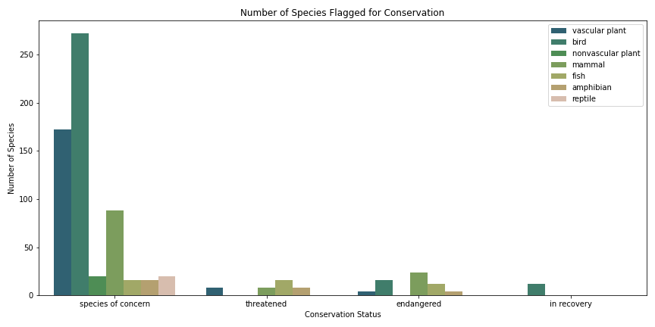
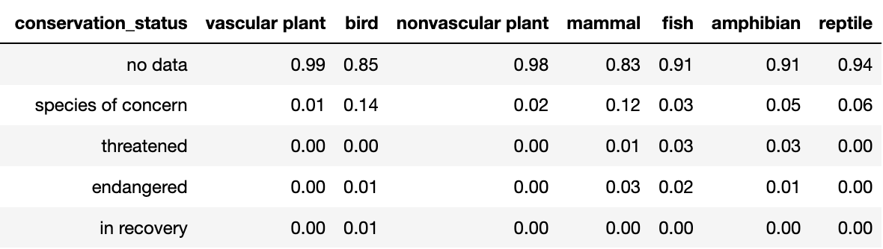
Analysis
The majority of species flagged for conservation are classified as species of concern.
Birds and mammals have the highest proportions of species of concern, about 13% each.
Mammals have both the highest number and the highest percentage of endangered species within our dataset, about 3% endangered.
Proportions of Species Flagged for Conservation
Yosemite

Slide 10
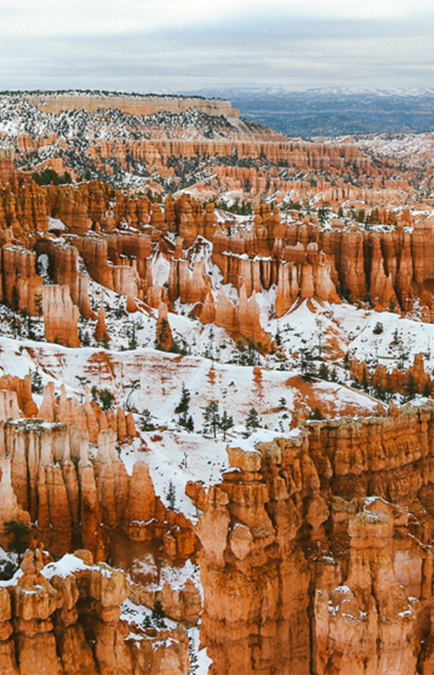
Conclusions
Fictional data = futile findings
Wildly inaccurate data renders analysis futile due to no real-world applications.
Conservation analysis reveals more realistic diversity distribution
Distribution of species flagged for conservation possibly based on real-world proportions.
Excellent exercise in data wrangling
Although Codecademy’s data-wrangling challenges may have led to fabricated dataset – and it was very fun to clean!
Bryce Canyon

Slide 11

Recommendations
Use accurate data for analysis
Utilize reliable data from kaggle or directly from the National Parks Service.
Incorporate environmental factors
Information regarding geographic location, climate patterns, and hunting offers context for endangered species.
Engage visitors through citizen science
Ask visitors to help log species both at parks and online through Zooniverse.
Great Smoky Mountains

